Slide 1
LegoFormers
Christian, Kiem, Amar, Efe

Slide 2
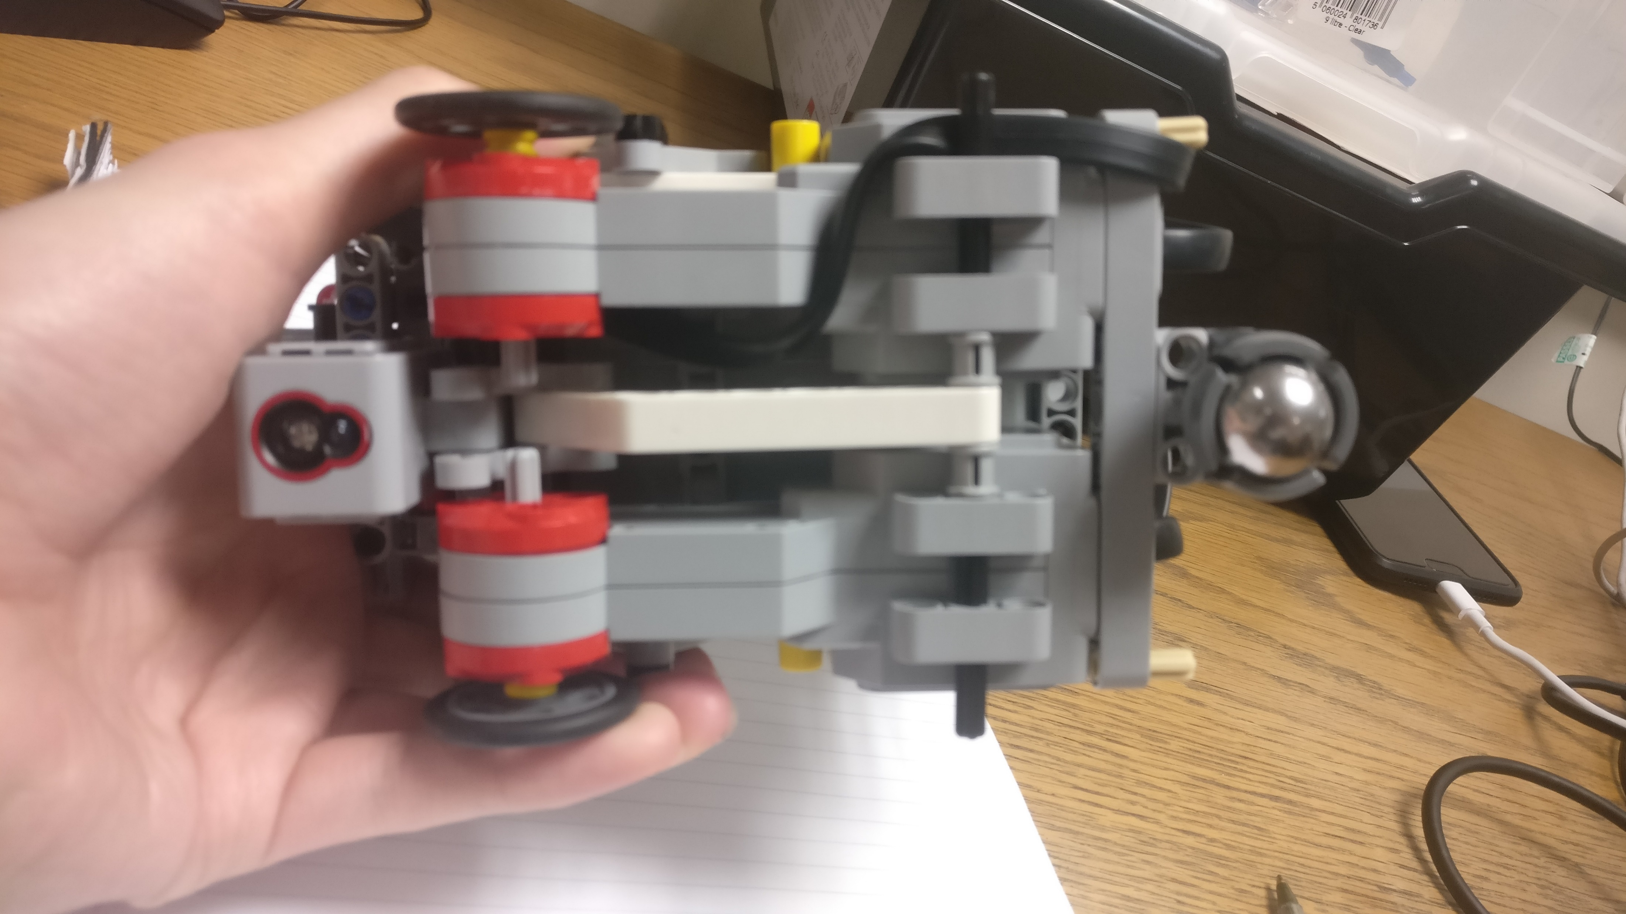
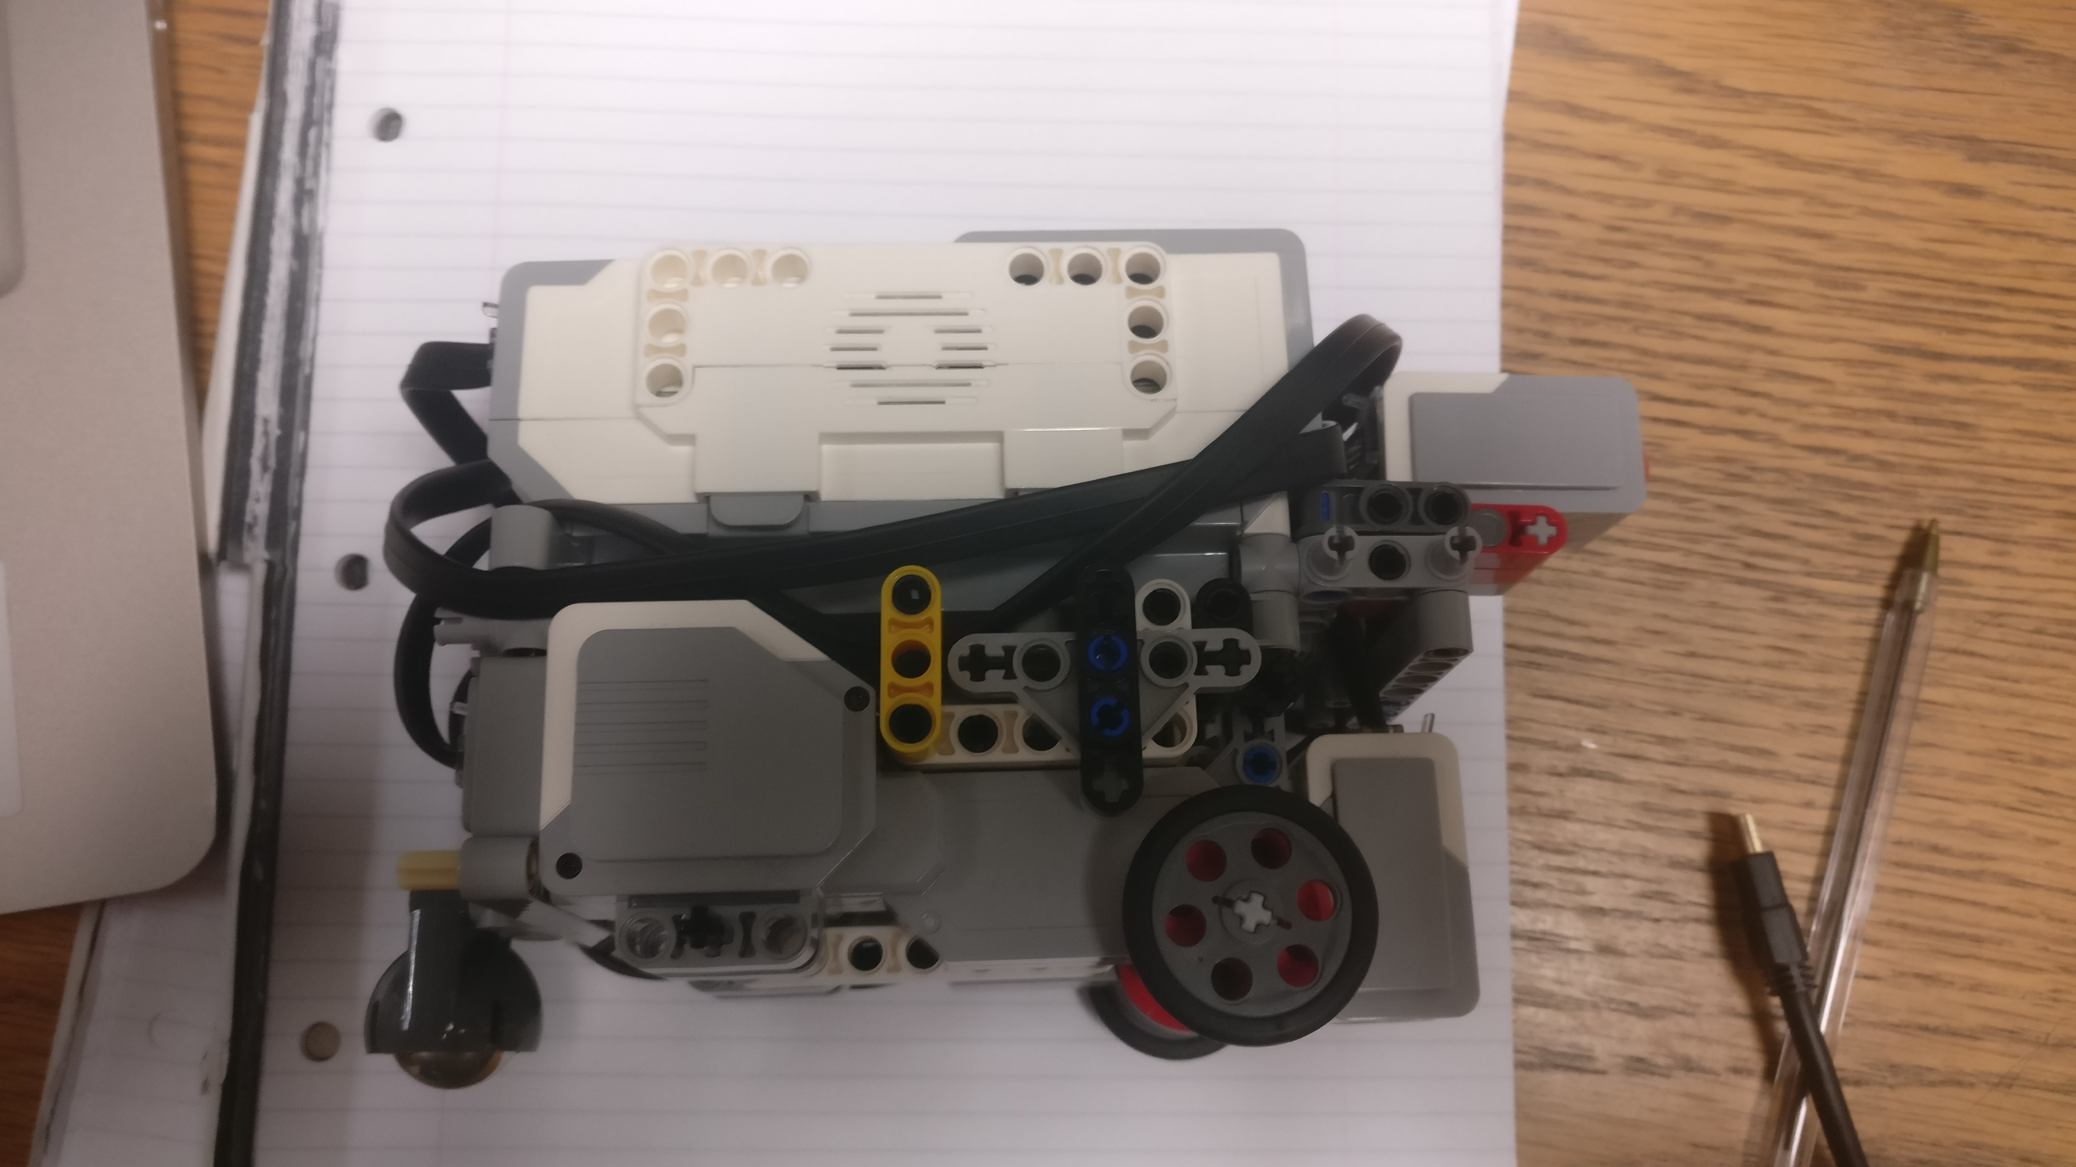
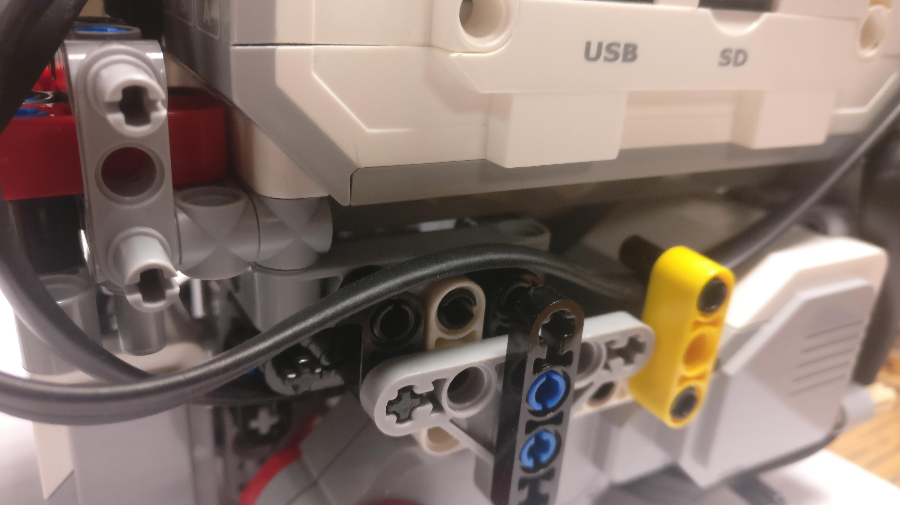
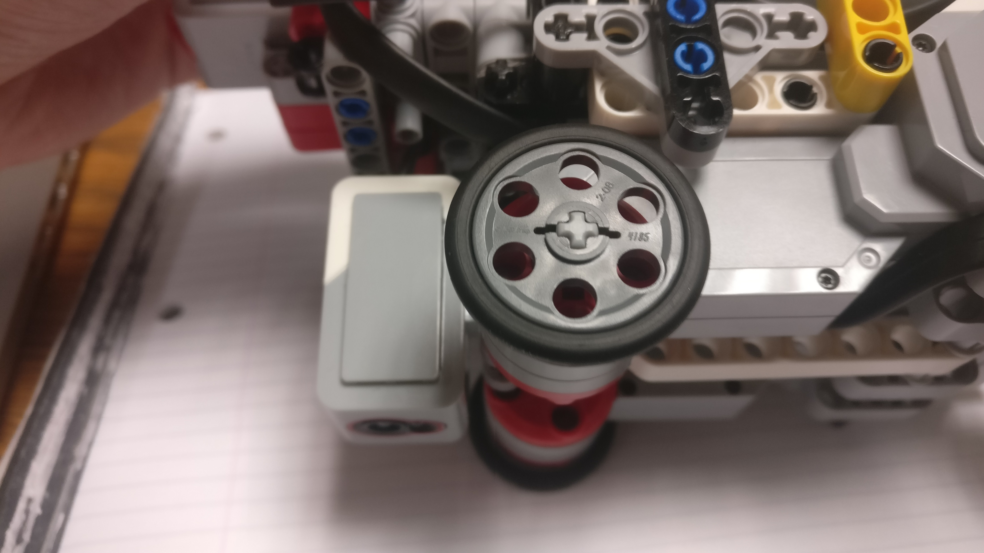
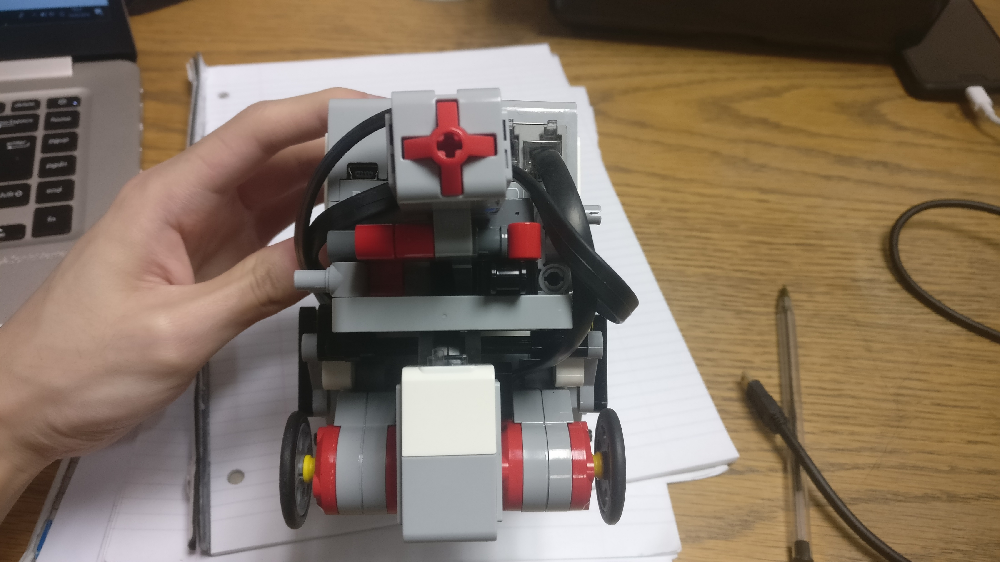
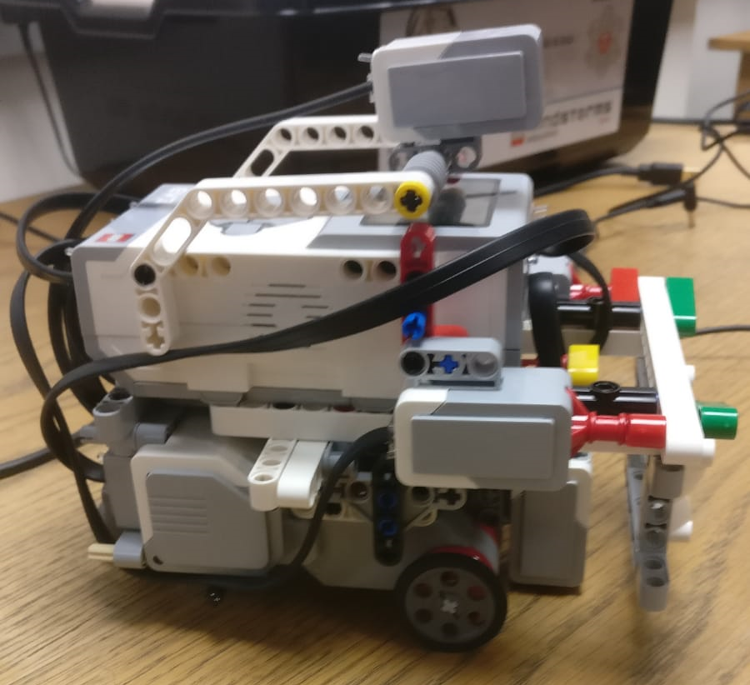
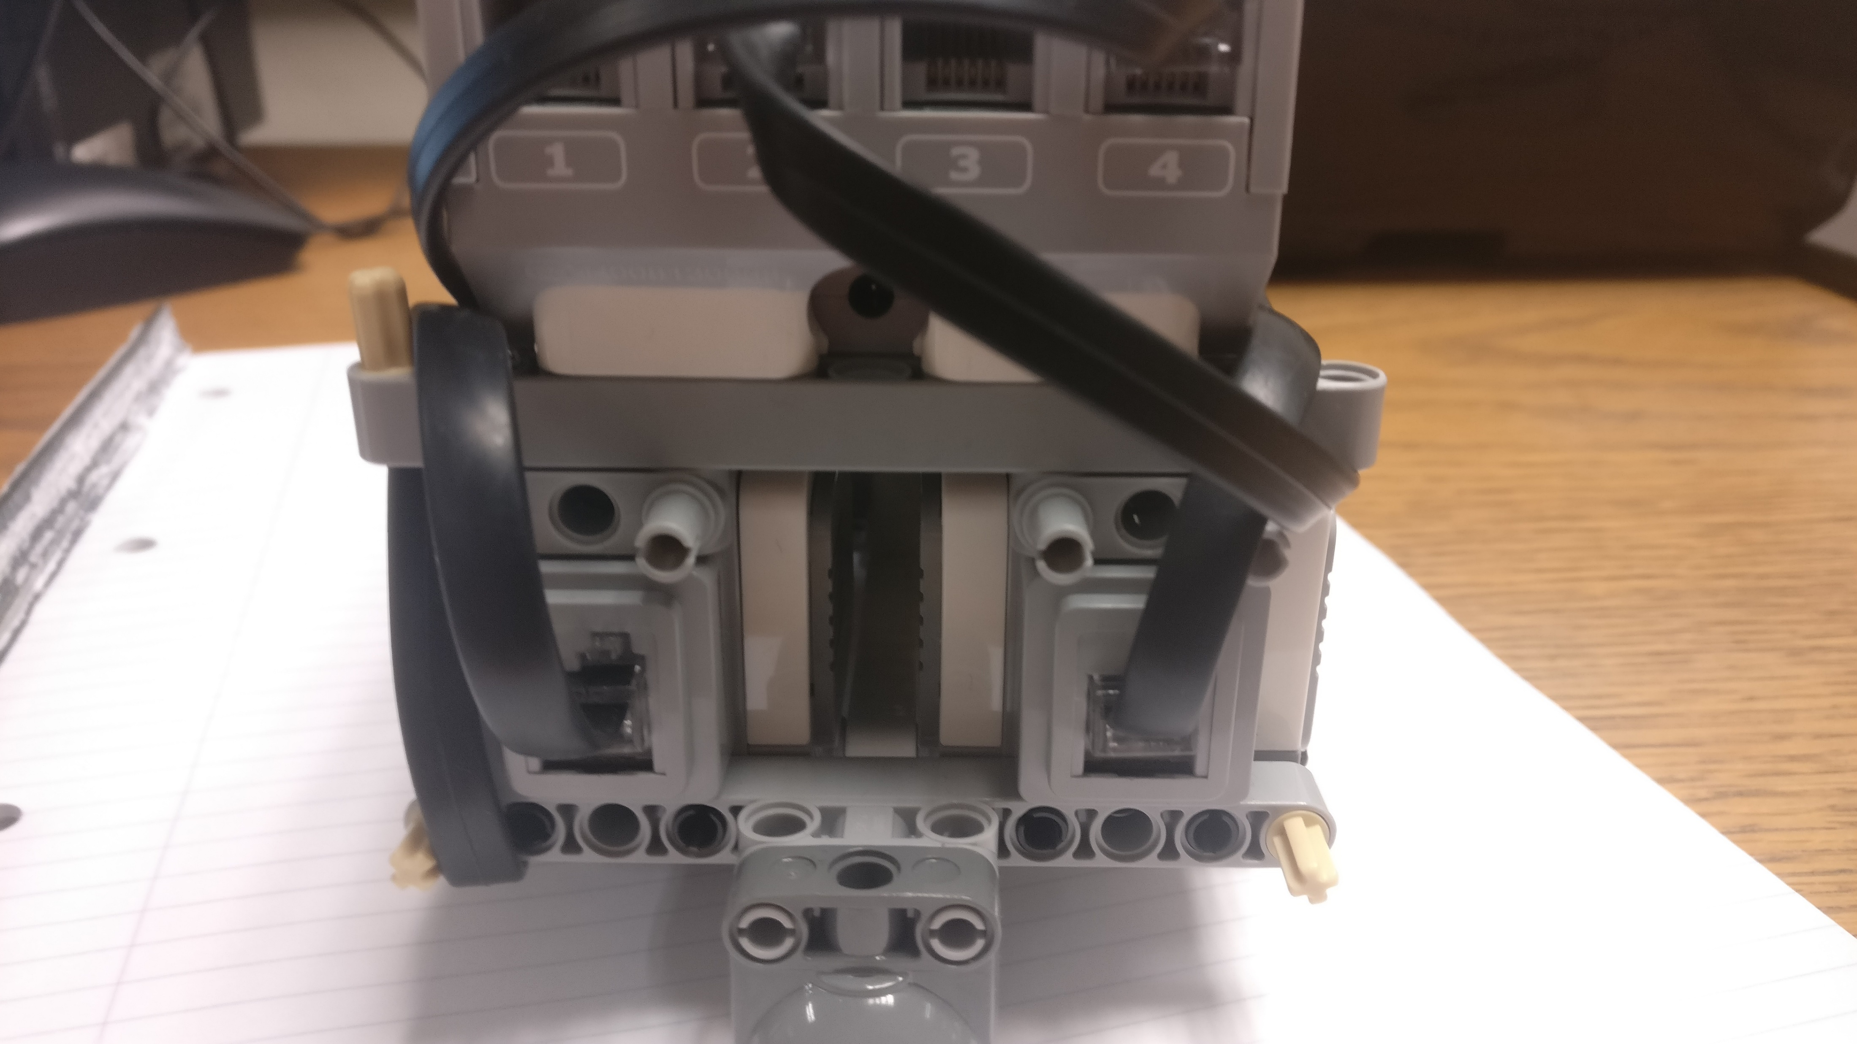
Robot Hardware Design
Physical Robot Design – a compact design to prevent collision with any obstacles
Colour Sensor – central position at the front of the robot to allow it to easily read the coloured paper in the garage
Motors – placed as close as possible to each other to ensure it has the smallest form factor
Touch Sensor – initially two sensors were used but required too much pressure for the push to be registered, so we remodeled the design to only have one sensor
Notes:
RGP Presentation
Physical Robot Design - The design of our robot is meant to be as compact as possible. This meant that all loose wiring has been hidden away so as not to collide with any obstacles in any way.
Gyro sensor (No longer used) - Our Gyro Sensor was placed so that it is directly above the axle of the wheels so that any rotation measurement is accurate and sensitive. However this placement meant that it would cover up the screen of the robot, making it difficult to get measurements from test runs. Therefore we decided to place the Gyro Sensor on a movable frame. We could then lift up the gyro once it has finished to easily retrieve readings.
Colour sensor - We wanted the colour sensor to be in a central position at the front of the robot so that it could easily read the colours placed in the garage, as opposed to being placed at the back of the robot, where it would rely on the coloured paper being placed further back. This also meant that the wheels would pull the paper backwards when it hit the wall as the wheels turn on the spot.
Motors - The two motors were placed as close to each other as possible to make it so that it has the smallest form factor. This was to reduce the chance of the robot hitting an obstacle as it is navigating the arena. We used differential drive
Touch sensor - Initially we used two touch sensors - one on either side of the robot so that when it collides with the back of the garage, both would have to be pressed for the colour sensor to be used. This was so that we can ensure the robot would be perpendicular with the back of the garage when it touches. However, a problem we faced was that it required too much force to press both of them and with the robot’s small wheels, this was not possible most of the time. Therefore, we decided to have just one touch sensor placed centrally in front of the robot so that it could be pressed with ease. The alignment problem would be solved easily by the Planning algorithm.

Slide 3
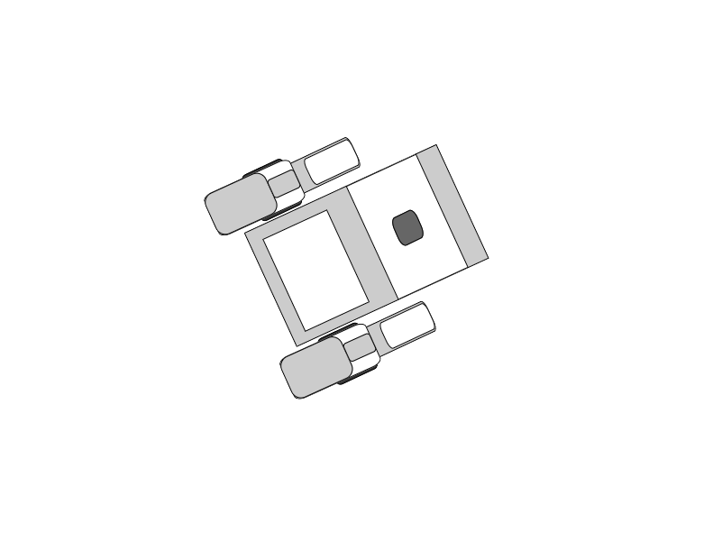
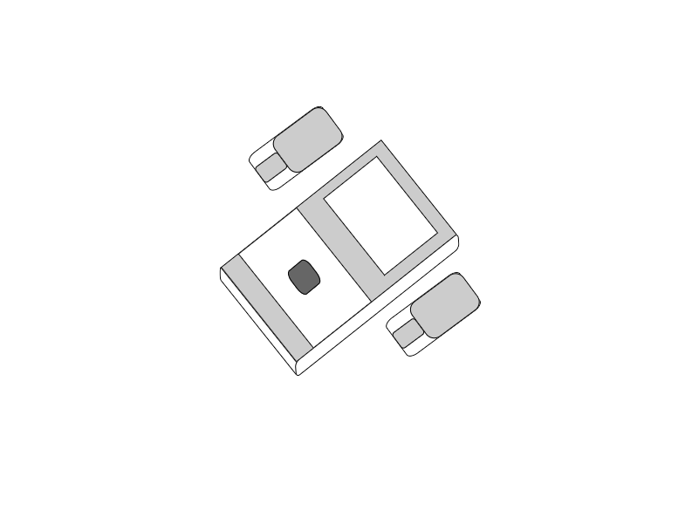
Robot Hardware Design
Our Initial designs for the robot, demonstrated a robust, compact and agile build. The Lego brick unit being our central component, we made sure to account for the accessibility of the various ports as well as the extensibility upon considering any future implementations. This enabled a flexible and dynamic workflow across the many iterations that were undergone during the early design process. Any additional components could very simply be connected to the robot’s main framework.
Large servo
motor
Touch sensor
LCD display
Main block unit

Slide 4
Software Design – Bayesian Localisation
Create probability array, with size being number of blue/white blocks on localisation strip
Fill array with equal probabilities, adding up to 1
Create array of booleans, where blue = true, and white = false, and boolean determining current colour
Create variables for moving and sensor working (close to 1)
Localise
While maximum probability in array is not over 50%
Get max probability
Use colour sensor to find current colour robot is on
Compare colour to colours in localisation strip colour array
If current colour sensed is the same as in array
Multiply probability at current location in probability array by probability of sensor working
If current colour is different to array colour
Multiply probability by probability of sensor not working
Sum all probabilities in array
Multiply all probabilities by (1 / total)
Move robot forward 1 step (1 block on strip)
Shift all probabilities to the right (2nd becomes 1st, 3rd becomes 2nd, etc…)
When a probability over 50% exists, find index it is at and return this value from method

Slide 5
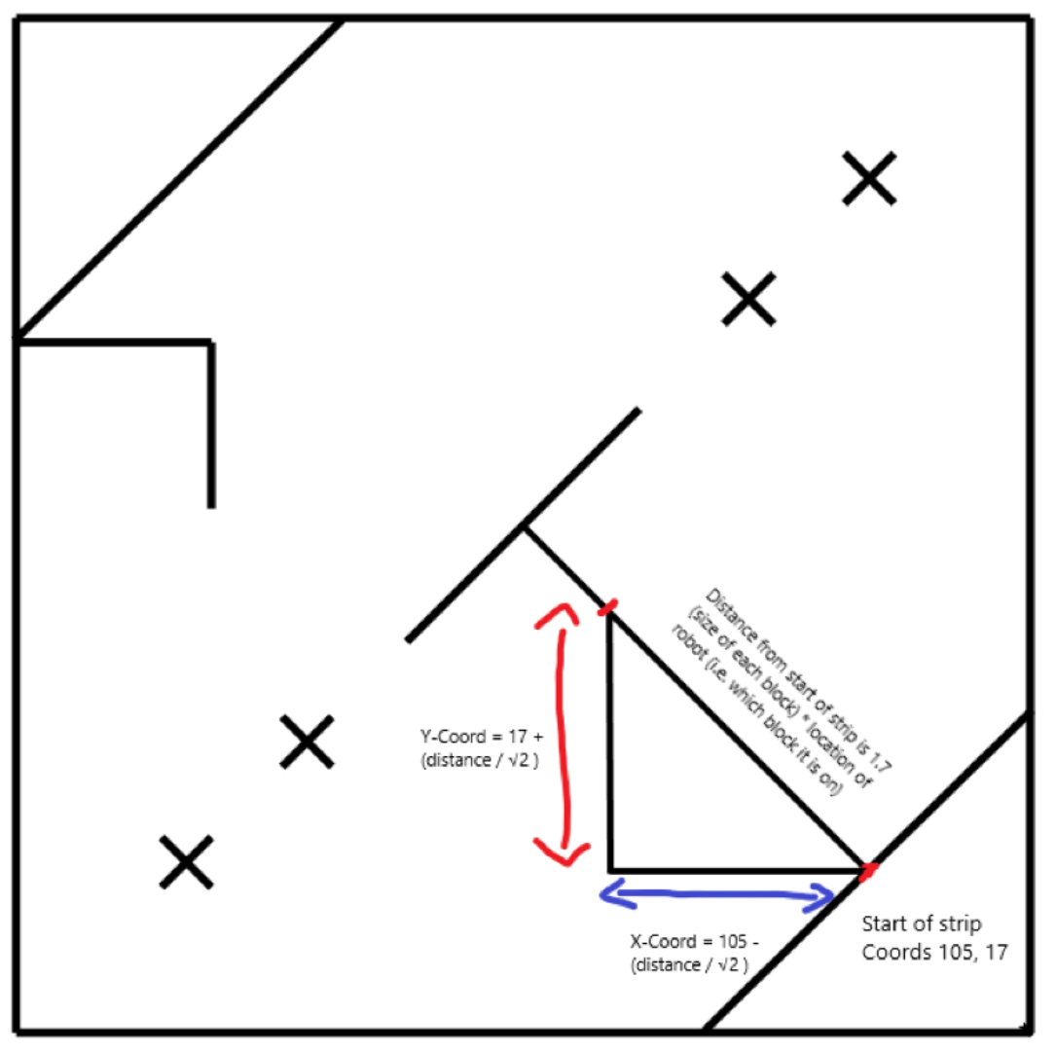
Software Design – Adding path planning to our version of localisation
Path planning turned the arena into a 122 x 122 block grid. The bottom left corner was considered as the origin (0, 0). Initially the robot’s starting coordinate was made as (102, 102), but this was clearly wrong so I made some adjustments to how the starting coordinate was calculated.

Slide 6
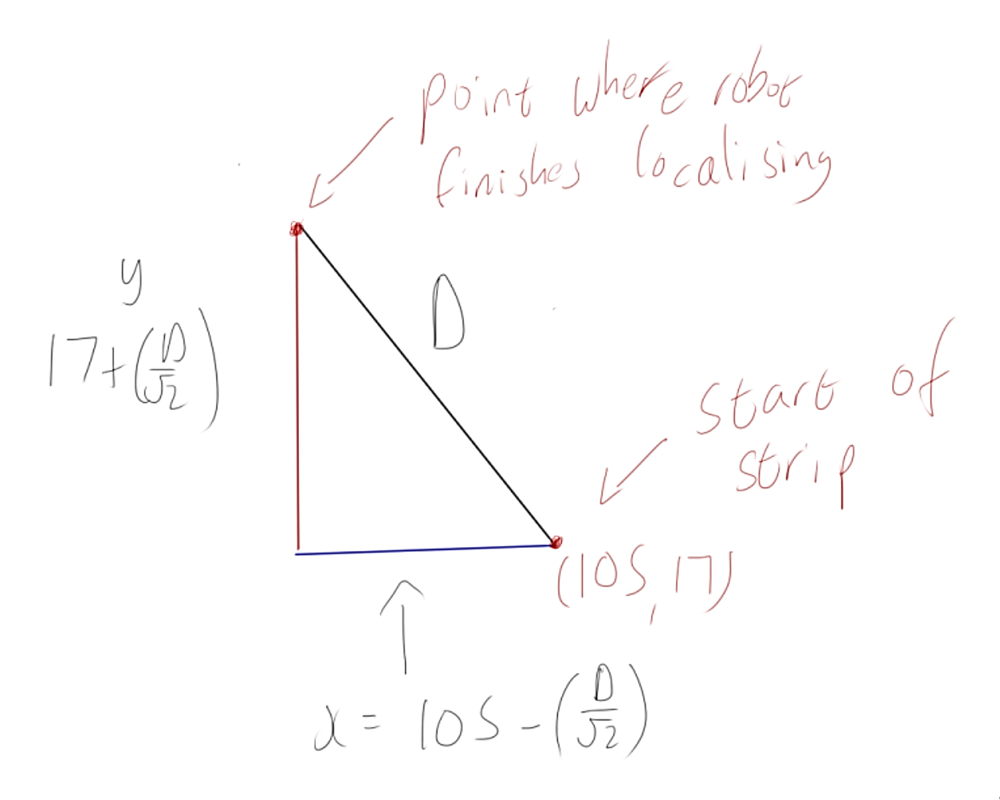
Adding path planning to our version of localisation
Using these coordinates, we got the robot to know where it was on the grid, and then we could add the path planning implementation to our code. This was then used when we created goals for the robot, where the robot could go to a location in the grid / arena.

Slide 7
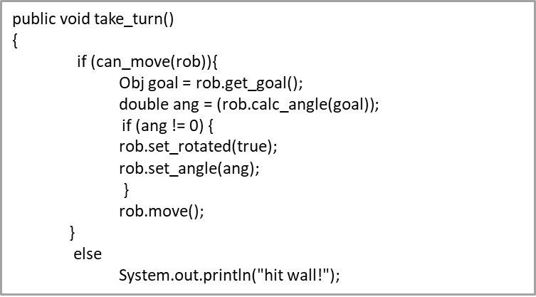
Software Design – Path Planning
For navigation, we used potential field in order to calculate the real time trajectory of the robots path, towards a given goal.
Every object in the field emits its own attractive and repulsive fields corresponding to the goal of our object and the obstacles to be avoided.
The system uses the current position of the robot and builds a path that will not collide with obstacles.

Slide 8
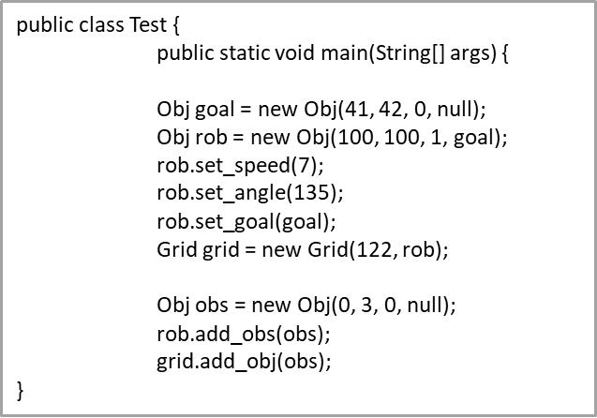
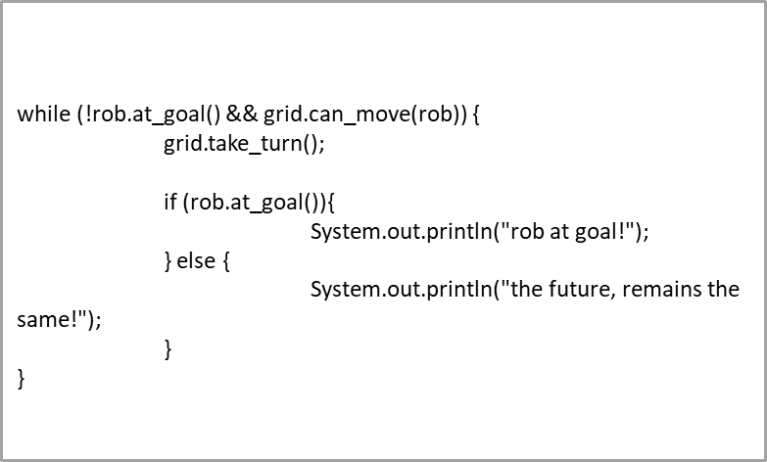
Unit Testing
Within the code base, we began developing a grid system as a separate module which would contain all the logic for the movements of objects, across the arena. So that we could test the system independently of the robot, we created a Test class.
This class was designed to unit test the functionality of the Grid and Obj classes. The test involved positioning the robot and random locations and setting the goal to test coordinates. Obstacles were added to the grid to resemble the actual arena. If the robot was unable to make it to the goal or it was to close to an obstacle then the test would fail, displaying the error. Otherwise, if the robot made it to the goal the assertion passed and a message “at goal” is printed to the screen.
The main benefit of structuring the code this way, was the ability to run all the grid related tests with or without the robot.
After the successful completion of the unit test we could then proceed to integration testing with the main module.

Slide 9
Team Management
Assigned a team leader - Track & arrange meeting times – to ensure we were working on time towards our goal - Manage work-flow during labs – to ensure that we were making progress during the labs - Delegate work – to ensure that everyone has work to do during the lab timings
Adopted a pair programming strategy - Bayesian Localization - A* Planning - Potential Field for Path Planning
Project Milestones - Early milestone: involved using the colour sensor to distinguish between red and green
- Robot successfully localizing itself in a consistent amount of time
- A* Path Planning reaching its first goal
- Integrating A* Path Planning into the localization implementation
Notes:
After having spent the first semester working on the Line Follower Project, we were all able to understand the strengths of every individual in our team, this made it easier to be able to assign tasks. We first appointed a group leader as we thought this semester project was quite challenging as it had different sections, i.e. the localization and path planning, which would then make sure we were working efficiently. After having agreed on I to become a team leader, we then started to discuss the tasks at hand. We split into two groups where two of us started to implement the part of localization that required us to convert the barcode into an array, the other two started of to figure out ways to actually use the values gained from the barcode, in order to localise the robot. For the path planning, we split into two groups. It was Efe and I who worked on A* Planning together and Christian and Kiem who worked on potential field. We split the team up for path planning and worked on the two different algorithms rather than one because half of us were more confident in the respective algorithms so we wanted to work on the areas that we each thought would make progress in.
Reflect upon first semester - understanding eachother strengths
Team Leader – benefits from having a team leader
Split into two groups 1) Kiem and I → starting to implement the barcode, splitting it into an array 2) Chris and Efe → starting to understand how to use this to find out where we were
Split into two groups 1) Efe and I → start to understand & implement A* Planning 2) Chris and Kiem → start to understand & implement Potential Field
Started group working on path planning, this involved testing and debugging the implementation

Slide 10
Conclusions
Possible Improvements
Increase our understanding of potential field in order to be able to implement a complete version of potential field
Version control could have been organised a lot more clearly. Git Hub was used but more as a central location for storing our different versions rather than using the actual features of Git Hub.

